Slide 1
High-Power and Ultra-Fast Photodiodes at THz Regime
Speaker: Prof. Jin-Wei Shi

Slide 2
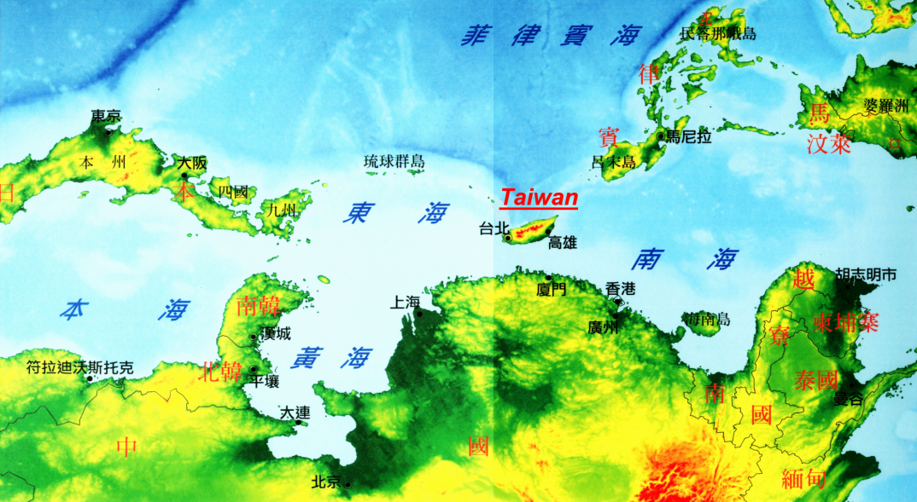


National Central University

Slide 3




National Central University
Prof. C.-B Huang
Notes:
My name is Jhih Min Wun. I come from NCU which locate at north Taiwan.
I want to thanks the Prof. C.-B Huang and his termroom in NTHU.

Slide 4
Outline
Introduction
Working Principle of NBUTC-PD
High-Power and Ultrafast Modulation Characteristic
Applications for MMW Over Fiber Communication
Conclusion

Slide 5
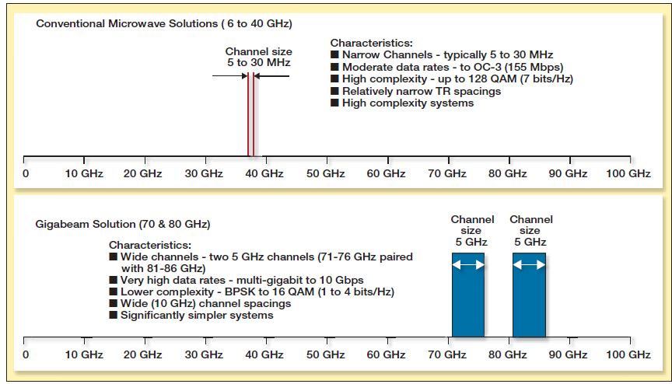

RF Spectrum Famine is happening
RF Spectrum Famine
MMW band can rescue us from famine of RF spectrum
Jonathan Wells “Fast Than Fiber: The Future of Multi–Gb/s Wireless,” IEEE Microwave Magazine, pp.104–112, May 2009.

Slide 6
How to obtain more bandwidth ?
Tadao Nagatsuma Ho-Jin Song, and Yuichi Kado,"Challenges for Ultrahigh-Speed Wireless Communications Using Terahertz Waves,"Terahertz Science and Technology,Vol.3, No.2, June 2010

Slide 7
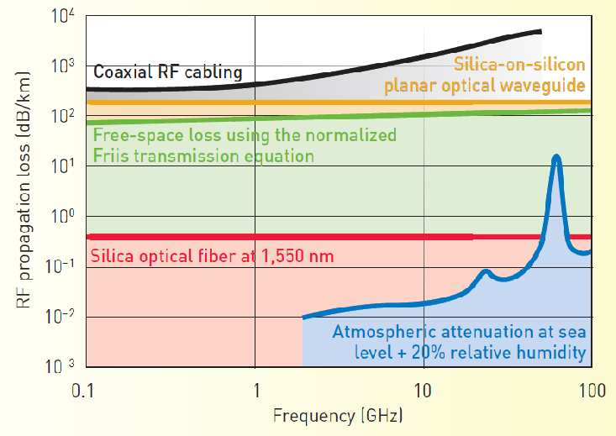
Why we need optical fiber for wireless ?
10³~10⁴ times
The loss of coaxial cable in Sub-THz frequency regime is much higher than that of optical fiber
Vincent J. Urick, John F. Diehl, Joseph M. Singley, Christopher E. Sunderman, and Keith J. Williams “Long-Reach Analog Photonics for Military Applications” Optics and Photonics News, Vol. 25, Issue 10, pp. 36-43 (2014)
Notes:
The loss of coaxial cable in Sub-THz frequency regime is much higher than that of optical fiber

Slide 8
Sub-THz PD…..
Tadao Nagatsuma Ho-Jin Song, and Yuichi Kado,"Challenges for Ultrahigh-Speed Wireless Communications Using Terahertz Waves,"Terahertz Science and Technology,Vol.3, No.2, June 2010

Slide 9
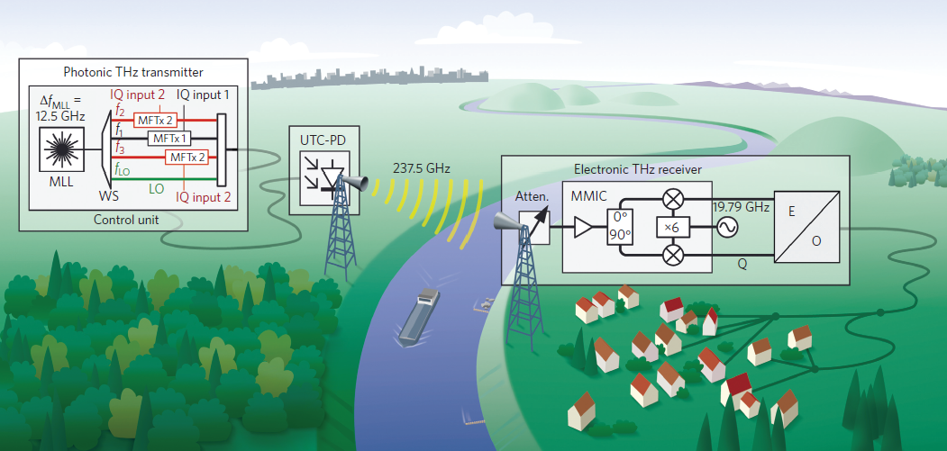
Why we need high-power sub-THz photo-diode ?
The sub-THz electrical amplifier is not ready yet
High-power Photodiode
We need PD which can deliver high power for long distance wireless links!
S. Koenig, D. Lopez-Diaz, J. Antes, “Wireless sub-THz communication system with high data rate.” Nature Photonics 7, 977- 981 (2013), October, 2013
Notes:
The most important application is Radio over fiber communications systems, where the combination
of electronics and photonics offers higher performance, lower cost and greater functionality.
But the sub-Thz amplifier may not be available.
So The High-power photodiode (PD) are the key components for long distance wireless links.

Slide 10
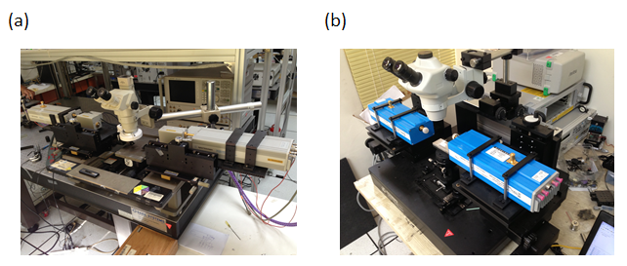
Photonic Sub-THz Measurement System
DC to 200GHz
DC to 110 GHz
110 to 170 GHz
Bulky and needs several sets for different bands !
Any solution ?? (single set from dc to ~300 GHz)
Notes:
Another application is photonic sub-THz measurement system . As you see, the equipments are Bulky and needs several sets for different bands .
So we want to Use a single Ultra-fast PD to replace bulky MMW-multiplier (NA extender).(倍頻器)

Slide 11
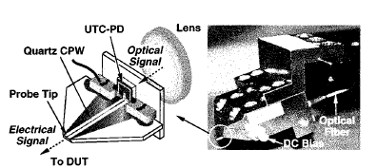
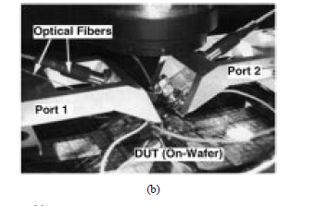
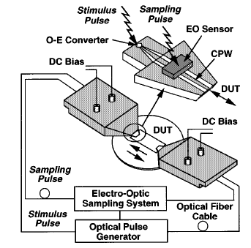
Photonic Sub-THz Measurement System
Photonic solution can cover
DC to 200GHz !
T. Nagatsuma, M. Shinagawa, N. Sahri, A. Sasaki, Y. Royter, and A. Hirata, “1.55−μm Photonic Systems for Microwave and
Millimeter-Wave Measurement,” IEEE Trans. Microwave Theory Tech., vol. 49, pp. 1831-1839, 2001.
Notes:
Photonic solution can cover DC to 200GHz !
In this figure, it can be use high power PD converter optical signal to MMW electrical signal.

Slide 12



Some Reported Solution-
Uni-Traveling Carrier Photodiode
UTC-PD*
Pin PD
Absorption layer
( P-doping)
Absorption layer
( intrinsic)
Anode
Anode
CB
VB
CB
VB
Diffusion block
Cathode
Cathode
Charge Storage
Electron Dominated Space-Charge Screening Effect !!
Hole Dominated Space-Charge Screening Effect !!
J_{max} ≈ (V_{bias}+ø)εV_{carriers} / D²
V_{hole} << V_{electron}
J_{max UTC} >> J_{max pin}
* H. Ito, S. Kodama, Y. Muramoto, T. Furuta, T. Nagatsuma, T. Ishibashi, “High-Speed and High-Output InP-InGaAs Unitraveling-Carrier Photodiodes,” IEEE J. of Sel. Topics in Quantum Electronics, vol. 10, pp.709-727, Jul./Aug., 2004

Slide 13
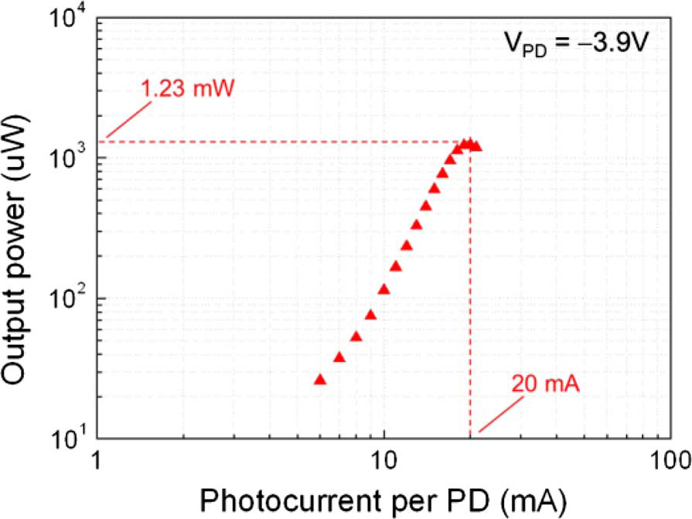
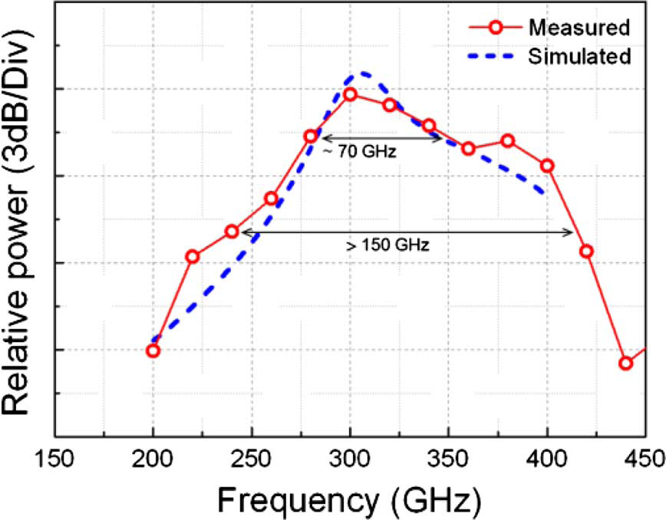
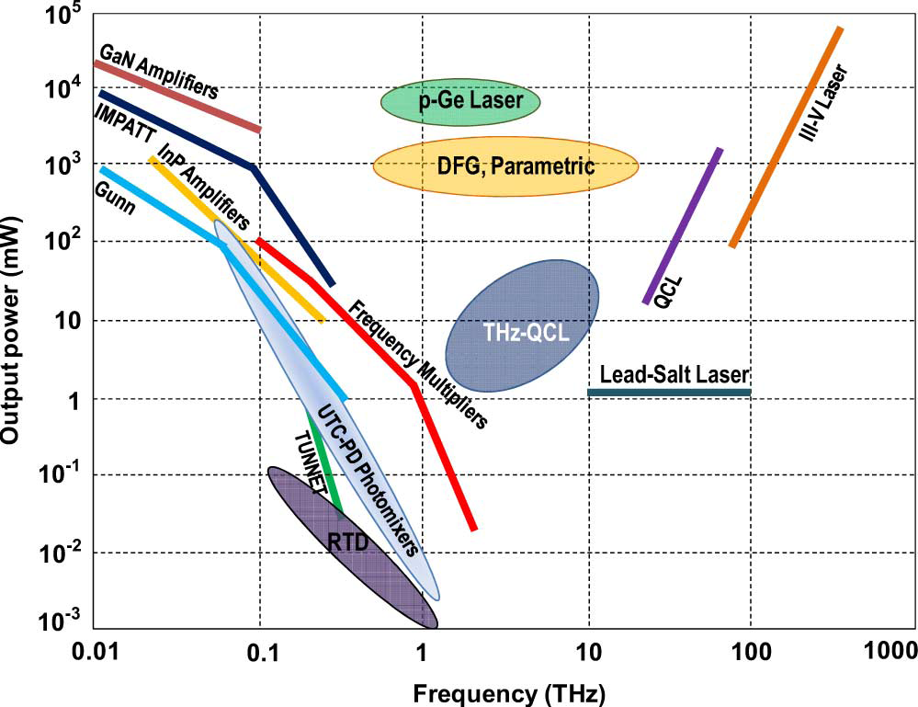
Limited Power from Sub-THz PD…..
Output power can up to 1.23mW
by dual UTC-PD at 300 GHz
Bandwidth can’t cover from DC
Good: Lossless optical interconnect
Bad :Less than 1mW at ~300 GHz regime
How to get more power (> 1mW) in sub-THz regime ?
Goutam Chattopadhyay, "Technology, Capabilities, and Performance of Low Power Terahertz Sources", IEEE TRANSACTIONS ON TERAHERTZ SCIENCE AND TECHNOLOGY, VOL. 1, NO. 1, SEPTEMBER 2011
Notes:
Here show several different kinds of THz generation techniques.
As you see, the UTC-PD photomixers can not offer a high such power compare with another techniques such as frequency multiplier.
But the most attractive advantage by use of photomixers is that we can have almost lossless optical interconnect by use of optical fiber.
But anyway , we still need more power to relays the communication in Sub-THz regime.

Slide 14
Outline
Introduction
Working Principle of NBUTC-PD
High-Power and Ultrafast Modulation Characteristic
Applications for MMW Over Fiber Communication
Conclusion

Slide 15


Why UTC-PDs Saturate?
(Field Screening)
(Space Charge Screening)
V_{eff} :minimum reverse bias voltage during dynamic operation
-
Veff
+
V_{bias} :external bias voltage
V_{bi} :built-in potential
P
J_{max} :maximum output photocurrent
i
R(Load)
A :active area
R :load resistance
N
F :fRC roll-off factor
Ddep
E_{c} :critical field
V_{e} : over-shoot drift-velocity
-
Vbias
+
ε :dielectric constant
D_{dep} :depletion layer thickness

Slide 16
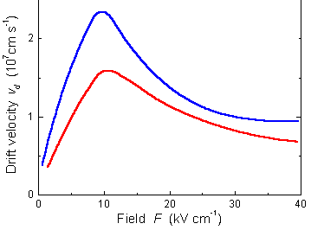
Case I:fT>>f3dB (Not sub-THz regime)
(Field Screening)
(Space Charge Screening)
Minor
(3)
(Thermal Degradation/Failure)
High-bias and good heat-sinking is necessary for high power

Slide 17
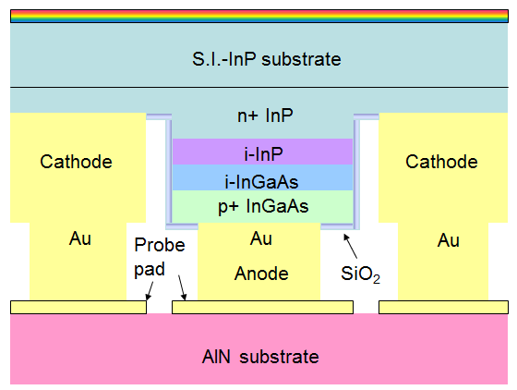
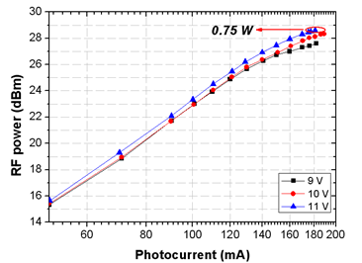
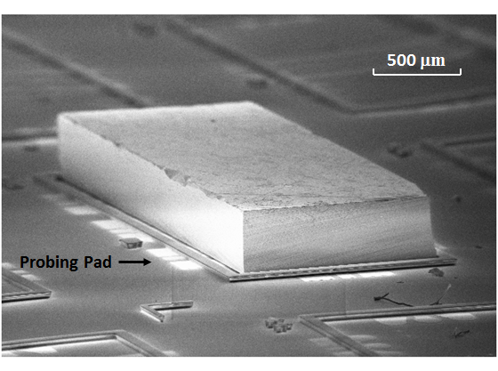
Case I: fT>>f3dB
(State-of-the-art High-Power Performance at 15 GHz)
180mA, 15GHz, 2700mA-GHz under 10ºC
But how about Sub-THz regime?
Zhi Li, Yang Fu, Huapu Pan, Andreas Beling, Joe C. Campbell, “Photodiode with 0.75 W RF Output Power at 15 GHz”, ECOC 2011

Slide 18
Case II:fT~f3dB (Sub-THz Regime)
(Field Screening)
(Space Charge Screening)
Serious issue!!
(3)
(Thermal Degradation/Failure)
You need a thin UTC-PD to attain sub-THz transient time
P
I
P
I
N
N
Substrate
Substrate

Slide 19
Case II:fT~f3dB (Sub-THz Regime)
(Field Screening)
(Space Charge Screening)
Serious issue!!
(3)
(Thermal Degradation/Failure)
Device Heating
You need a thin UTC-PD to attain sub-THz transient time
P
Also, you need a small size to sustain a sub-THz RC-limited bandwidth
P
I
I
N
N
Substrate
Substrate

Slide 20
Miniaturized PD: Heat is the killer !!
(Field Screening)
(Space Charge Screening)
(Thermal Degradation/Failure)
300K
Device Heating
500K
P
Serious Degradation on Overshoot Drift Velocity!
I
N
Substrate
Fawcett, W. and G. Hill, Electron. Lett 11, 4 (1975) 80-81.

Slide 21
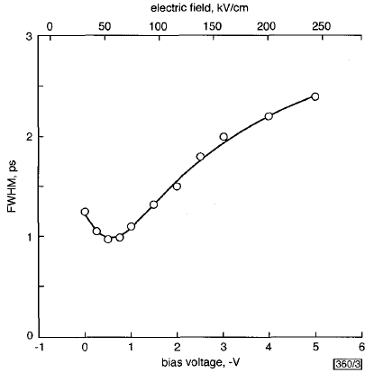
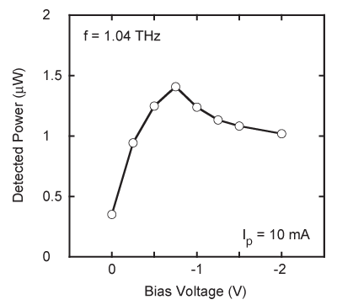
Sub-THz regime: High-Bias Works ?
Pulse Measurement(No heating) Under 12.5ΩLoad
CW Measurement (Heating)
External saturation effect ?
Best Speed Performance for Maximum output power
~0.7V for Best Speed Performance
Increasing V_{bias} doesn’t work (Intervalley scattering/Heat issue !!)
A small optimum V_{bias} (External circuit Saturation effect)
H. Ito, T. Furuta, S. Kodama and T. Ishibashi,"InP/lnGaAs uni-travelling-carrier photodiode with 310GHz bandwidth", ELECTRONICS LETTERS 12th October 2000 Vol. 36 No. 21
H. Ito, T. Furuta, F. Nakajima, K. Yoshino and T. Ishibashi,"Photonic Generation of Continuous THz Wave Using Uni-Traveling-Carrier Photodiode", JOURNAL OF LIGHTWAVE TECHNOLOGY, VOL. 23, NO. 12, DECEMBER 2005

Slide 22
How to Further Increase Power in Sub-THz Regime?
(Field Screening)
Possible!
Limited by fRC
(Space Charge Screening)
Material
(3)
(Thermal Degradation/Failure)
How to increase Veff in the same Thickness (Ddep) without seriously sacrificing Ve (less heating)??
Let Near-ballistic transport happens in the higher V_{bias} regime !!

Slide 23
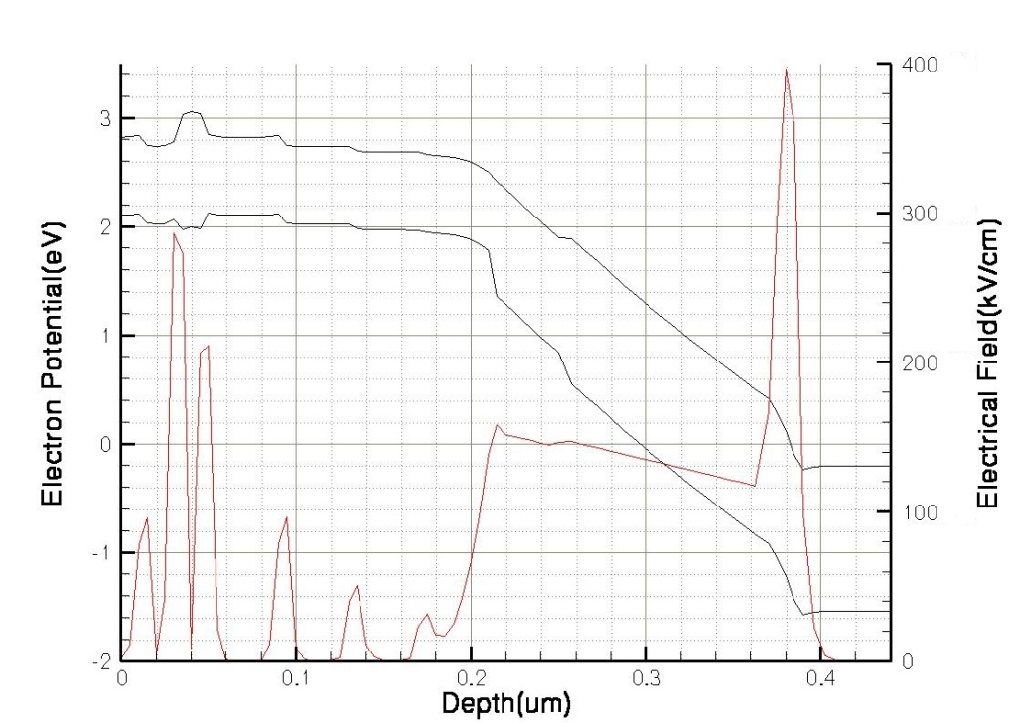
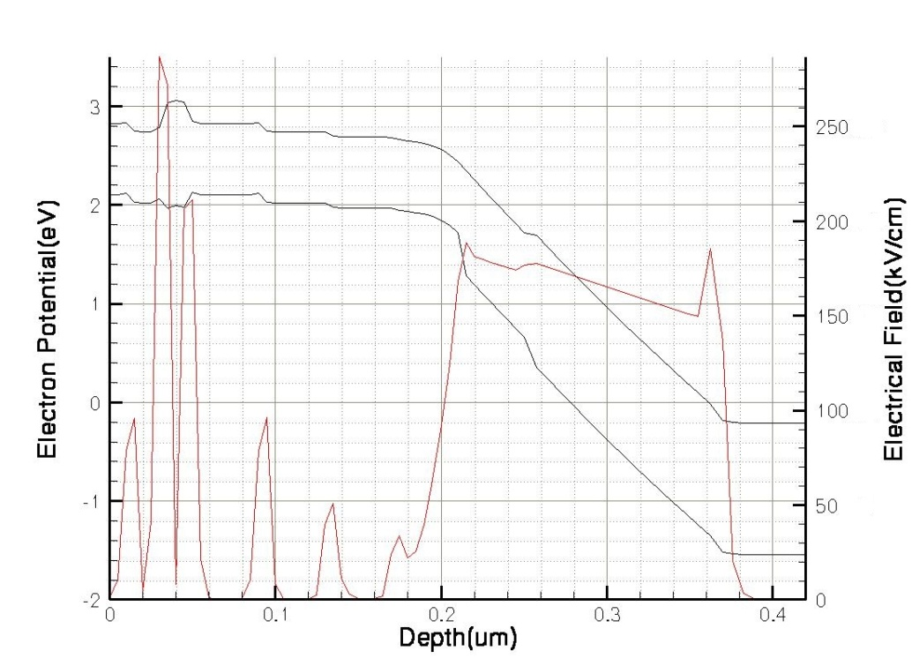

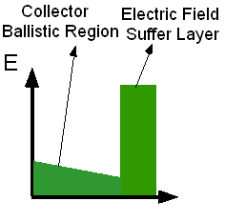
Our Solution: The NBUTC-PD
Low field in the collector Near Ballistic Transport(~Ve)
Electrical field simulation
-1.5V
High Veff (External bias) Minimize the external screening
effect (But thermal becomes an issue)
180KV/cm
Collector
120KV/cm
Velocity overshoot
(120nm)
Charge layer
(20nm)
NBUTC
UTC
-
Veff
+
Lower field in the collector
T. Ishibashi and Y. Yamauchi, “A possible near-ballistic collection in an AlGaAs/GaAs HBT with a modified collector structure,” IEEE Trans. Electron Devices, vol. 35, no. 4, pp. 401–404, Apr. 1988.

Slide 24
Another Solution: n-charge layer
at B-C junction
N-doping:
7 nm,
8.3×10¹⁷cm⁻³
Nearly zero electric field under high current operation!
The screening of E-field at AC junction can be minimize!
N-charge: To smartly re-distribute the E-field under low bias….

Slide 25
Outline
Introduction
Working Principle of NBUTC-PD
High-Power and Ultrafast Modulation Characteristic
Applications for MMW Over Fiber Communication
Conclusion

Slide 26
The breakthrough of NBUTC-PD:
Geometrical Structure of PD array
Optical MMW Source
Good Heat-Sinking for Sub-THz Operation

Slide 27
Combined Several Devices: Traveling- Wave PD (TWPD)
V₀
V₁
V₂
V_{N}
Dummy Load
Drawback
3dB photo-generated MMW power is sacrificed Dummy Load
Bragg cut-off limited bandwidth Periodic Structure
How can we overcome
these drawbacks ?
The net bandwidth is limited by Single PD
Transmission Loss limited bandwidth Major Bandwidth Limitation

Slide 28
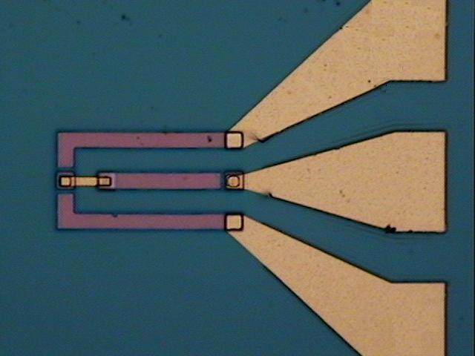
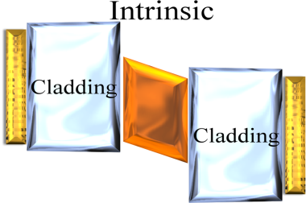
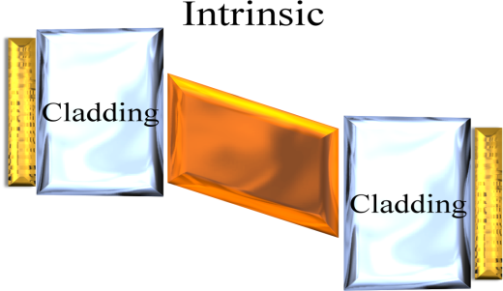
Our Solution: Cascade NBUTC-PD
Series of several high-speed PDs
R_{Load}
125μm
Short carrier drift time !!
R_{Load}
I_{toatal}
Capacitance equal to….
Active area
A thin depletion layer (Short carrier drift-time) with a released RC-bandwidth !!
Dummy load and complex E-O design are both not necessary !! (50Ω load)

Slide 29
How about high-power performance of cascade PD?
Will the increase of series resistance be a issue? R nR ?
<
Improve RC-limited bandwidth
by use of cascade structure !!
D_{N}
(nR+50)*C/n
(R+50)*C
Cascade Structure:
V_{bias}
R_{Load}
D₂
➔ Although current can’t increase as parallel (TWPD), we can increase size of single-PD for the desired bandwidth to enhance saturation current due to reduction of capacitance.
I_{toatal}
D₁
➔ Although V_{bias ,}Total area thermal problem ~

Slide 30
Power Performance
Measured Saturation Current-Bandwidth Product is record high as “7500mA-GHz” (100GHz, 75mA)
The Output Power Performance of our
2-Cascade-NBUTC-PD is superior to
UTC-PD+HEMT Amplifier Module!!
Record high saturation current-bandwidth product (7500mA-GHz, 91GHz) under a 50Ω load.
Akihiko Hirata, Hiroyuki Takahashi, Ryoichi Yamaguchi, Toshihiko Kosugi,Koichi Murata, Tadao Nagatsuma, Naoya Kukutsu, andYuichi Kado,
“Transmission Characteristics of 120-GHz-BandWireless Link Using Radio-on-Fiber Technologies,” JOURNAL OF LIGHTWAVE TECHNOLOGY, VOL. 26, NO. 15, AUGUST 1, 2008

Slide 31
Benchmark for High Power PD
 | Bandwidth (GHz) | Saturation current & Bandwidth Product (mA*GHz)
Parallel-fed TWPD (p-i-n PD) [1] | 80 | 1760mA۰GHz
Parallel-fed TWPD (UTC-PD) [2] | 17 | 1938mA۰GHz
Single UTC-PD [3] | 170 | 2380mA-GHz
Single CCUTC-PD [4] | 50 | 2500mA.GHz
Cascade NBUTC-PD [this work] | 100 | 7500 mA۰GHz
A. Beling, J. C. Campbell, H.-G. Bach, G. G. Mekonnen, and D. Schmidt, “Parallel-Fed Traveling Wave Photodetector for >100-GHz Applications,” J. of Lightwave Technol., vol. 26, pp. 16-20, Jan., 2008
A. Beling, H. Chen, H. Pan, and J. C. Campbell, “High-Power Monolithically Integrated Traveling Wave Photodiode Array,” IEEE Photon. Technol. Lett., vol. 21, Dec., pp.1813-1815, 2009.
3. H. Ito, T. Furuta, F. Nakajima, K. Yoshino, T. Ishibashi, “Photonic generation of continuous THz wave using uni-traveling-carrier photodiode,” J. of Lightwave Technol., vol. 23, pp. 4016-4021, Dec., 2005.
4. N. Li, X. Li, S. Demiguel, X. Zheng, J. C. Campbell, D. A. Tulchinsky, K. J. Williams, T. D. Isshiki, G. S. Kinsey, and R. Sudharsansan, “High-Saturation-Current Charge-Compensated InGaAs-InP Uni-Traveling-Carrier Photodiode,” IEEE Photon. Technol. Lett., vol. 16, Mar., pp.864-866, 2004.

Slide 32
The breakthrough of NBUTC-PD:
Geometrical Structure of PD array
Optical MMW Source
Good Heat-Sinking for Sub-THz Operation

Slide 33
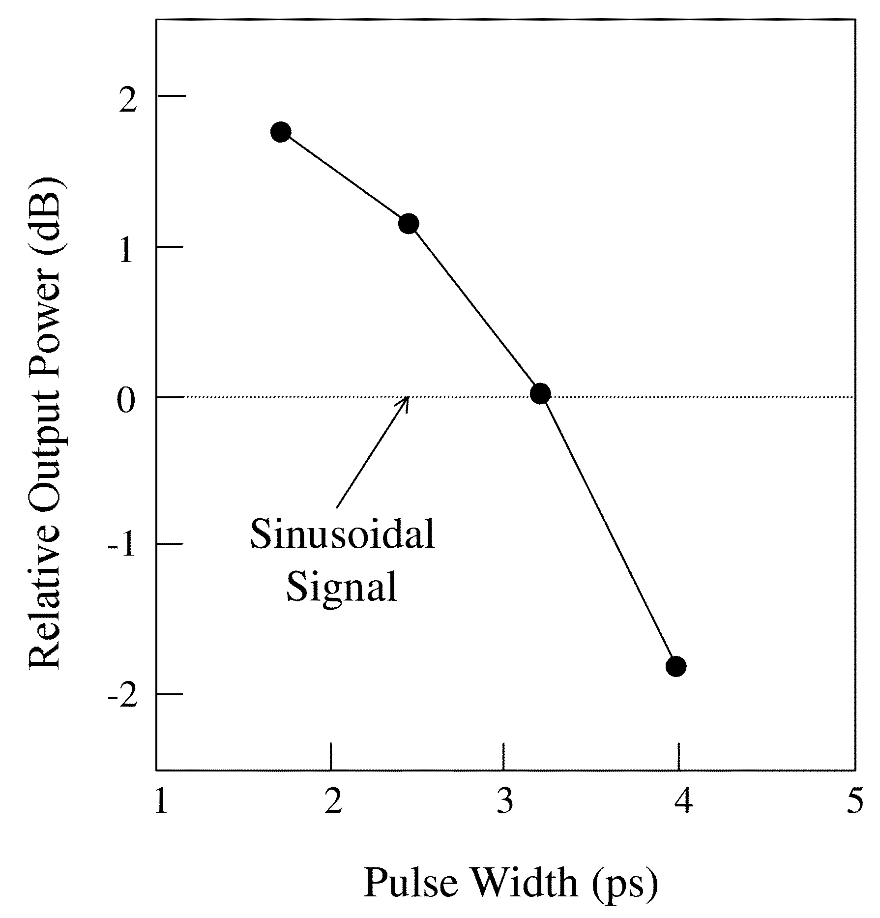

Why we need shorter pulse?
Modulation depth ↑
Enhance power ↑
But why?
Akihiko Hirata, Mitsuru Harada, and Tadao Nagatsuma,"120-GHz Wireless Link Using Photonic Techniques for Generation, Modulation, and Emission of Millimeter-Wave Signals,"J. of Lightwave Technol., vol. 21, pp. 2145–2153 ,2003.
Notes:
In the same photocurrents ,the different modulation depth will have different transfer efficiency for RF Signal.
So we need shorter pulse to get high modulation depth and Enhance power .
The figure shows the Shorter Pulse Provide Higher MMW Power.

Slide 34
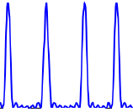
MMW spectral power enhancements
Each pair of two-tone contributes to MMW power
Theoretically enhancement “6dB”
F.-M. Kuo, J.-W. Shi, H.-C. Chiang, H.-P. Chuang, H.-K. Chiou, C.-L. Pan, N.-W. Chen, H.-J. Tsai, and C.-B. Huang, “R Spectral Power Enhancement in a 100-GHz Photonic Millimeter-Wave Generator Enabled by Spectral Line-by-Line Pulse Shaping .” IEEE Photonics Journal,Vol.2, Issue 5,pp.719-729 ,Oct ,2010
Notes:
The figure shows the optical field amplitudes for the time-domain sinusoid and pulse.
As can be see, Each pair of two-tone contributes to MMW power .
Theoretically[͵θiəˋrɛtɪk!ɪ] enhancement power is 6dB.

Slide 35
Summarize the advantages of short pulse
Duty Cycle↓
Sinusiodal Singal
Shorter Pulse
Improvement :
1. Reduce thermal effect for photodiode
2. High modulation depth→Enhancement power ↑
Notes:
So if we use shorter pulse ,we have two important Improvement .
Because the smaller duty cycle, we can Reduce thermal effect .
And by use shorter pulse, we also have High modulation depth to obtain more Enhancement power .

Slide 36
Adaptive Photonic MMW Source for Access Network
Generate 1-ps optical pulse train (~400 GHz rept. rate) for higher MMW power!!
Indepently Manipulate Phase and Amplitude of each comb line!!

Slide 37
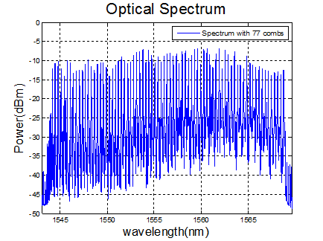
Photonic MMW Source (IV)
Line-by-line shaped comb spectrum
The measured time-domain intensity autocorrelation traces of the 280 GHz pulse
FWHM 300fs ＜ 1ps
Notes:
The figure shows the optical spectrum and 160GHz pulse.
So we could have Full-Width Half-Maximum 285fs much lower than 1 ps.

Slide 38
Record-High Photo-Generated 124 GHz MMW Power: Optical MMW Short Pulse Source
MMW Power increases with number of comb lines (pulse width shortening)
15 dBm, 31 mW
Record-high MMW power (31 vs. 20 mW (UTC-PD))

Slide 39
The breakthrough of NBUTC-PD:
Geometrical Structure of PD array
Optical MMW Source
Good Heat-Sinking for Sub-THz Operation

Slide 40
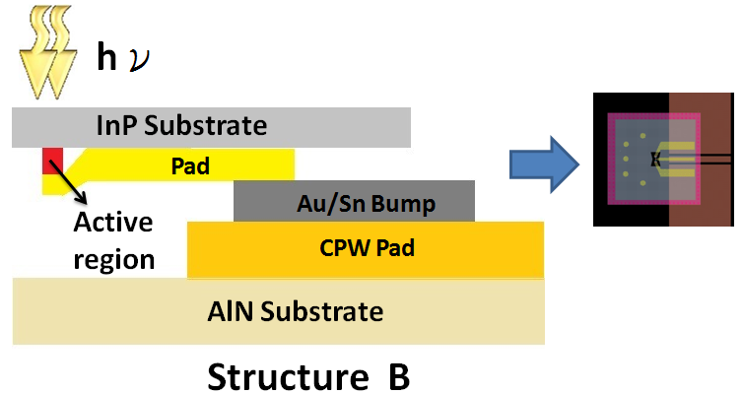
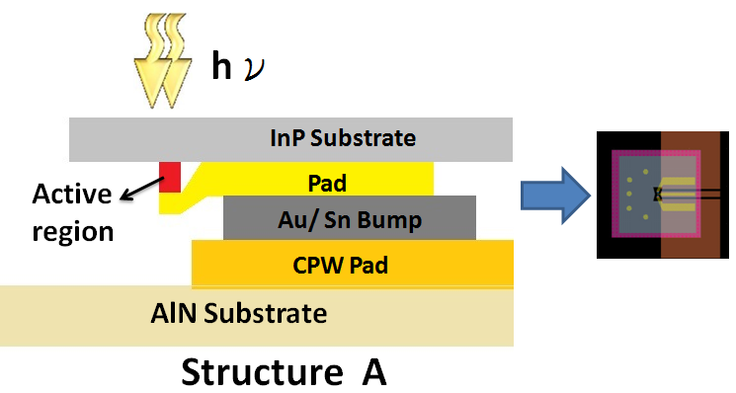
cross-sectional view (after flip-chip bonding) of structures A and B
Maybe Yield
Yield
Speed
Speed
Heat-sinking
Heat-sinking
Signal
Signal

Slide 41
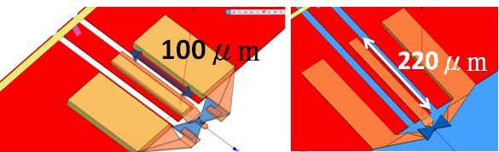
Modeling Flip-Chip bonding structure
O-E bandwidth
Flip-Chip bonding structure has strong influence on O-E bandwidth!
Notes:
Here shows the modeling result for PD which is bonding on the AlN structure. Flip-Chip bonding structure has strong influence on O-E bandwidth!

Slide 42
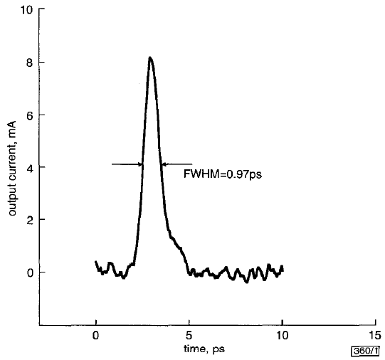
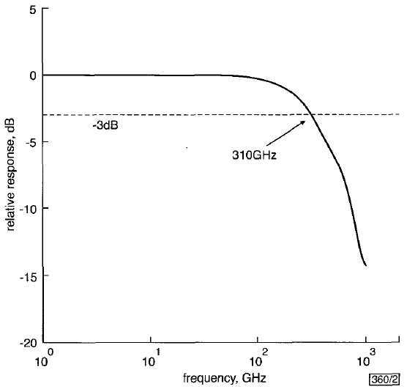
Record Fastest PD (1.55 μm) …
InP/lnGaAs uni-travelling-carrier
photodiode with 310GHz bandwidth
Under 12.5 Ohm load: Poor output power
No reported saturation current
Low responsivity (<0.01 A/W)
Notes:
１．很爛的輸出功率
２．沒說明飽和電流
３．很差的響應度

Slide 43
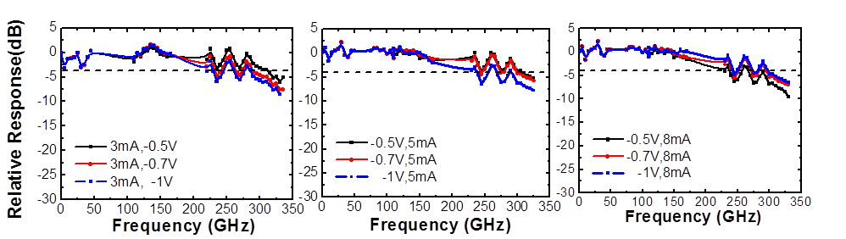
Measured and modeling O-E bandwidth
315GHz
300GHz
300GHz
Under low output photocurrent (3 mA), the optimum bias for maximum speed performance happens at -0.5 V. (“50 Ohm load”)
when the output photocurrent reaches 8 mA, the optimum bias shifts to -1V (SCS effect) .
Further increase in reverse bias doesn’t help for speed and power
Notes:
Under low output photocurrent (3 mA), the optimum bias for maximum speed (~315 GHz 3-dB bandwidth) performance happens at -0.5 V. On the other hand, when the output photocurrent reaches 8 mA, in order to compensate the electron induced SCS effect, the optimum bias shifts to -1V and the corresponding 3-dB bandwidth slightly degrades to 290 GHz.
GHz.

Slide 44
Measured and modeling O-E bandwidth
Measured Bandwidth up to 315 GHz, ~0.1 A/W Responsivity
Optimum bias: -0.5~-1V (O-E f_{3dB} > 315 GHz)
Notes:
In the O-E bandwidth measurement, our 3 dB is up to 160 GHz.

Slide 45
THz power measurement results
Enhancement (3.23 dB) in
high photocurrent operation regime: “Record high” output power for THz (~0.3 THz) bandwidth PD
12mA

Slide 46
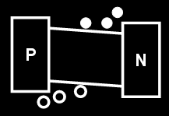
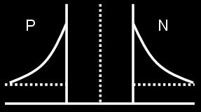
Significant Bias Dependent Speed Performance: Switch !!
Under reverse bias still has high nonlinearity!!
Without minority carrier injection under forward bias voltage
Very-high modulation speed!!

Slide 47
High On/Off Ratio
1.1V
20dB
>36dB

Slide 48
High On/Off Ratio
Current doesn’t change during switching!!
>36dB

Slide 49
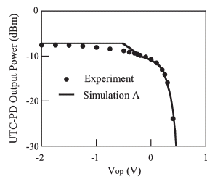
High On/Off Ratio
Best MMW Switch: High on/off ratio, Ultra-fast switching speed, low-driving voltage
>36dB
NTT’s UTC-PD
A. Hirata, T. Furuta, H. Ito, and T. Nagatsuma, “10-Gb/s Millimeter-Wave Signal Generation Using Photodiode Bias Modulation,” J. of Lightwave Technol., vol. 24, pp. 1725–1731, April. 2006.
Forward

Slide 50
Outline
Introduction
Working Principle of NBUTC-PD
High-Power and Ultrafast Modulation Characteristic
Applications for MMW Over Fiber Communication
Conclusion

Slide 51
Wireless Data Transmission

Slide 52
Power Performance
18mA, 6.3dBm
Improved Power performance due to better Heat-sinking

Slide 53
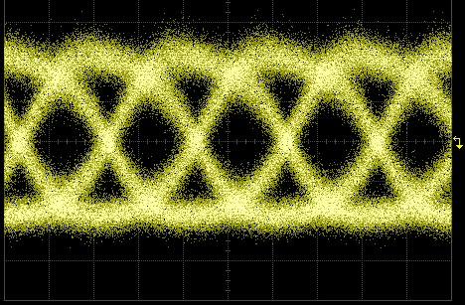
25Gbit/s Wireless Data Transmission
Eye Height: 63mV Eye Width: 20ps
Error Free Performance!! (BER<1e-12)

Slide 54
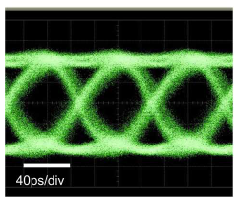
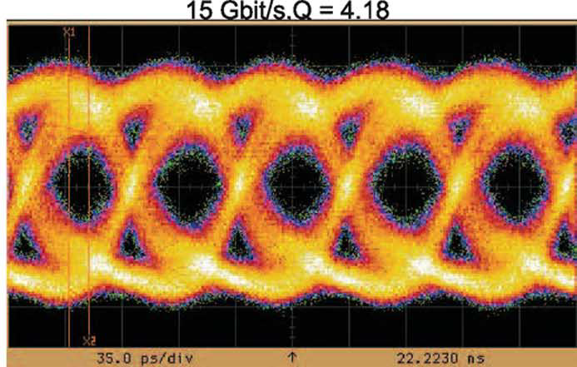
25Gbit/s Wireless Data Transmission
This Work
25Gbit/s at 93GHz
NTT 48 Gbit/s at 300GHz
Fraunhofer Institute for Applied Solid-State Physics(IAF)
15Gbit/s at 220GHz
Highest Data Rate at Lowest Carrier Frequency!!

Slide 55
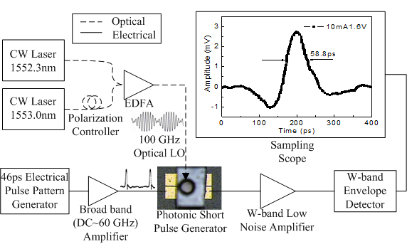
Photonic MMW Short Pulse Generator
Not femtosecond Mode Lock Laser
Beating Signal
Few Cycle MMW
Short Pulse
Bias Modulation
Notes:
Photonic MMW Short Pulse Generator

Slide 56
Radar Imaging System
Receiver
B.
A.
Detected Target
(Focus Point)

Slide 57
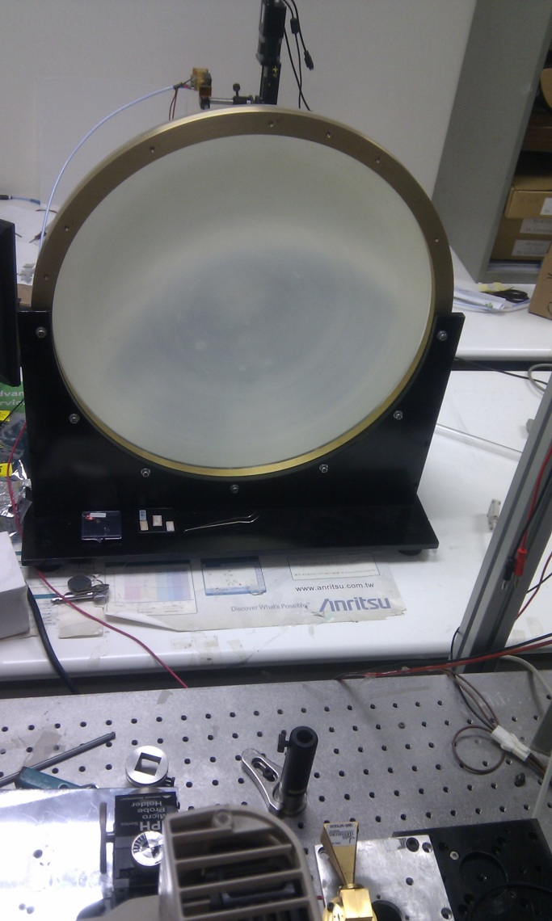
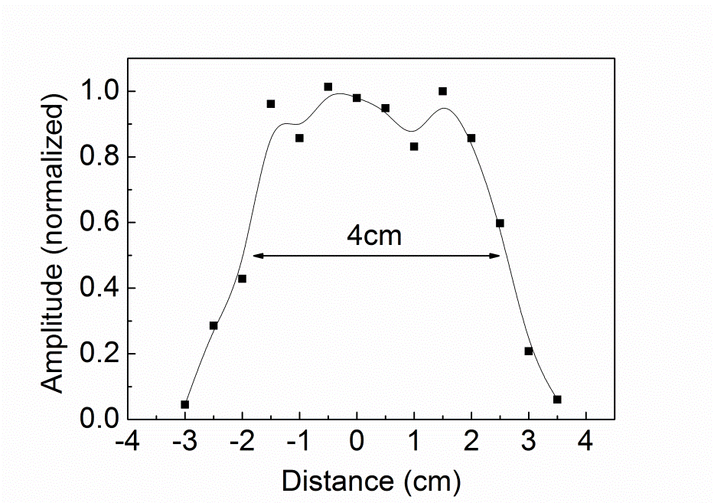
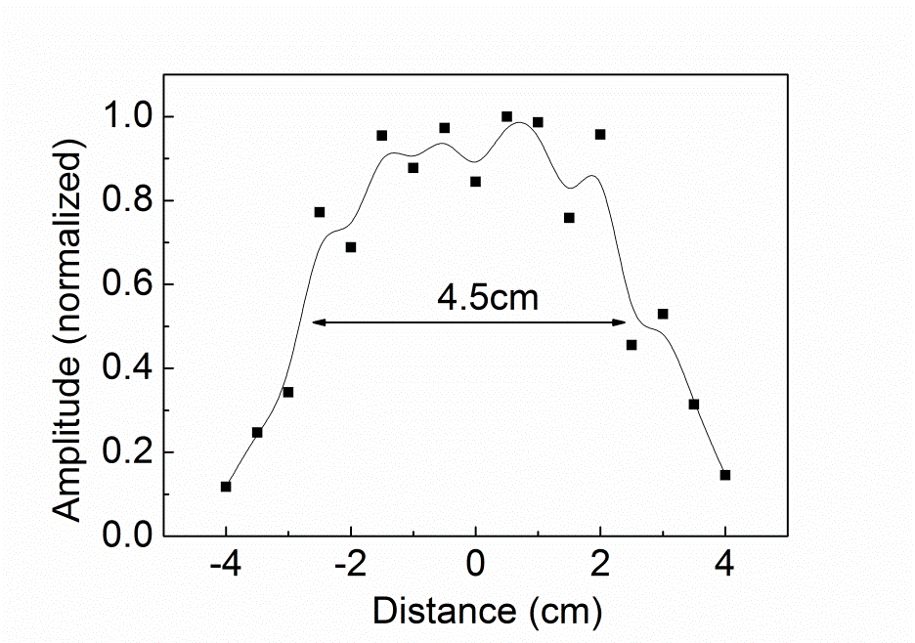
Resolution Measurement
Temporal Resolution
Receiving Horn
1.053 cm
MMW Lens
Transmitting Horn
Spot Size
Spatial Resolution

Slide 58

Object Image Measurement
Security Check
Envelope
Object Under Test

Slide 59
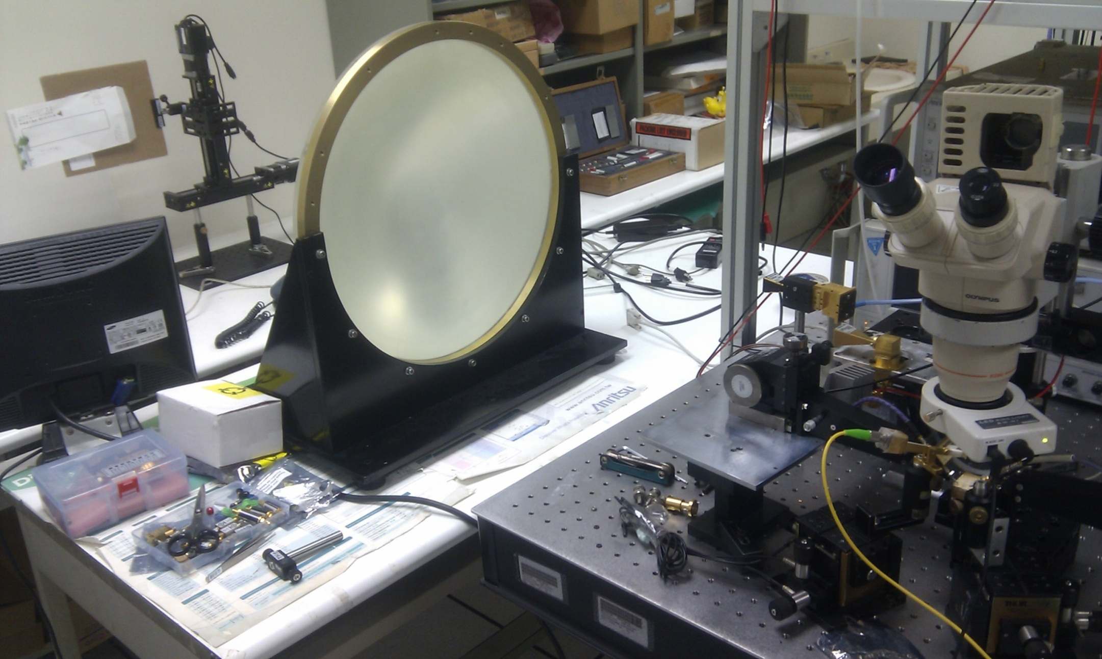
Object Image Measurement
Object Under Test
Receiving Horn Antenna
Transmitting Horn Antenna
Millimeter Wave Lens
Photonic Short
Pulse Generator

Slide 60
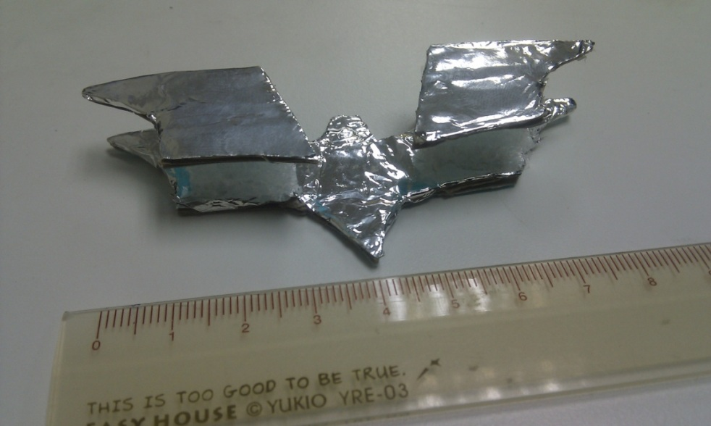
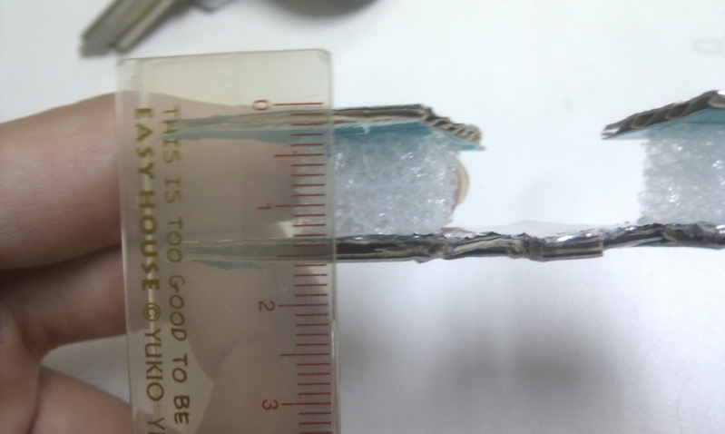
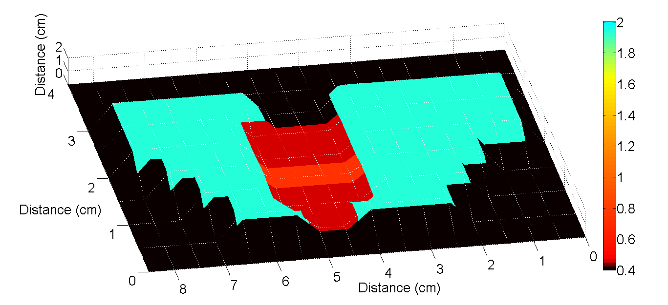
Object Image Measurement

Slide 61
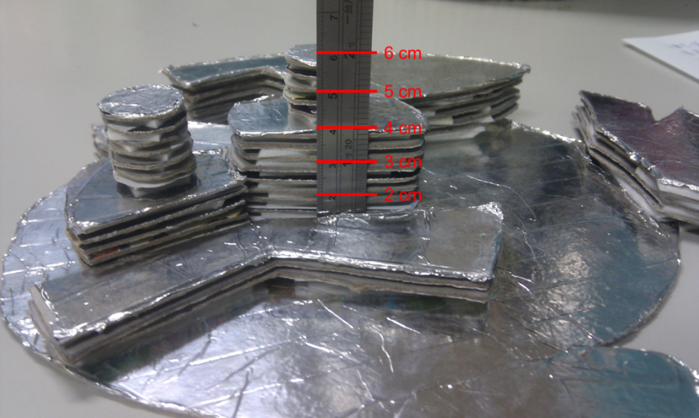
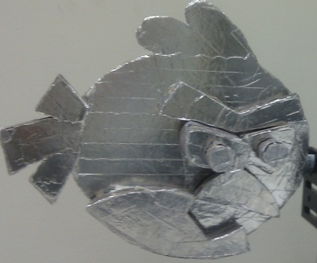
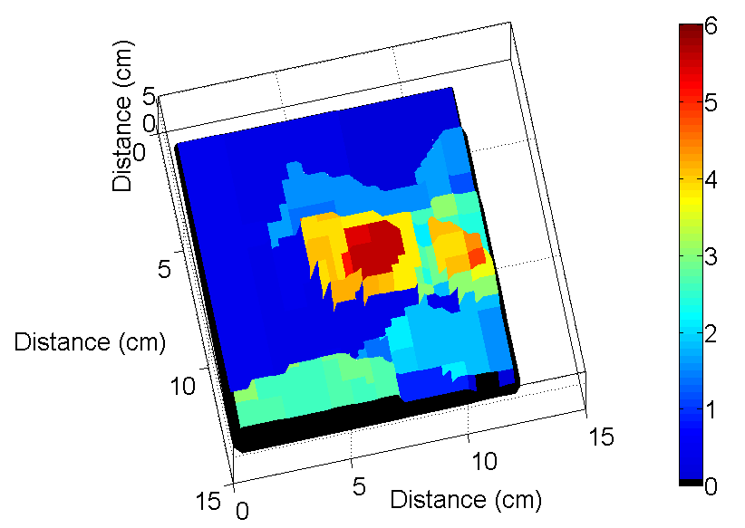
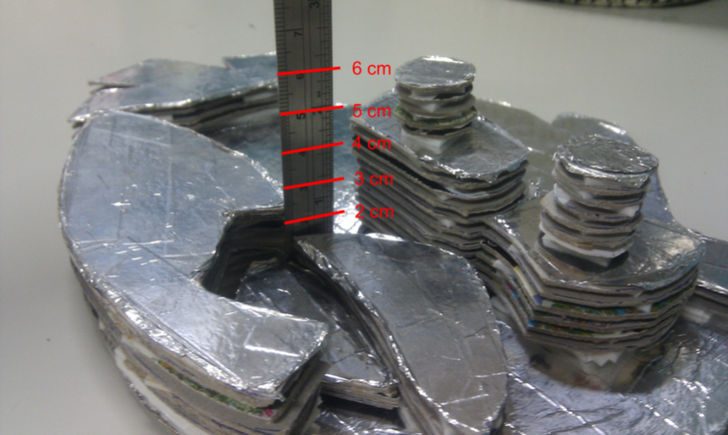
Object Image Measurement

Slide 62

Table.1. Comparisons of Different MMW Radar Systems
Benchmark of MMW Radar Imaging
[2] K. B. Widener, and J. B. Mead, “W-band ARM Cloud Radar-Specifications and Design” Fourteenth ARM Sci. Team Meeting Proc., Albuquerque, New Mexico, USA, March, 2004.
[3] P.-S Tsai, and S. Frasier, “The UMass Mobile W-band Radar: System Overview and Sample Observations” 24th Conference on Severe Local Storms, Savannah, Georgia, USA, June, 2008, P13.5
[4] R. W. McMillan, C. W. Trussell, Jr. R. A. Bohlander, J. C. Butterworth, and R. E. Forsythe, “An Experimental 225 GHz Pulsed Coherent Radar”, IEEE Trans. on Microwave Theory Tech., vol. 39, pp. 555-562, March, 1991.
[10] A. Y. Nashashibi, K. Sarabandi, P. Frantzis, R. D. De Roo, and F. T. Ulaby, “An Ultrafast Wide-Band Millimeter wave (MMW) Polarimetric Radar for Remote Sensing Applications”, IEEE Trans. on Geoscience and Remote Sensing, vol. 40, pp. 1777-1786, Aug., 2002.
[11] H. Essen, H.-H. Fuchs, M. Hagelen, S. Stanko, D. Notel, S. Erukulla, H. Huck, M. Schlechtweg, A. Tessmann, “Concealed Weapon Detection with Active and Passive Millimeterwave Sensors, Two Approaches” German Microwave Conference, Karlsruhe, Germany, March, 2006.
[12] H. Essen, S. Stanko, R. Sommer, W. Johannes, A. Wahlen, J. Wilcke, and S. Hantscher, “Millimeter Wave SAR for UAV Operation” Proc. Asian-Pacific Microwave Conference 2011, Melbourne, Australia, Dec., 2011, pp. 963-966.

Slide 63
Outline
Introduction
Working Principle of NBUTC-PD
High-Power and Ultrafast Modulation Characteristic
Applications for MMW Over Fiber Communication
Conclusion

Slide 64
Conclusion
Higher optimum bias for near-ballistic transport in NBUTC-PD : p-type (or n-type) charge layer in collector
Record high output power for PD with THz bandwidth (0.3 THz)
Ultra-fast switching characteristic: Field-effect to modulate electron drift-velocity (good MMW switch !!)
High Performance photonic-transmitter mixer: Good PD modeling and MMW design
State-of-the-art resolution of photonic radar system has been demonstrated
Very-High error-free wireless data rate (25 Gbps) with high-power performance (~ 20mA) saturation current)

Slide 65
Thanks for your attention !!

